Slide 1

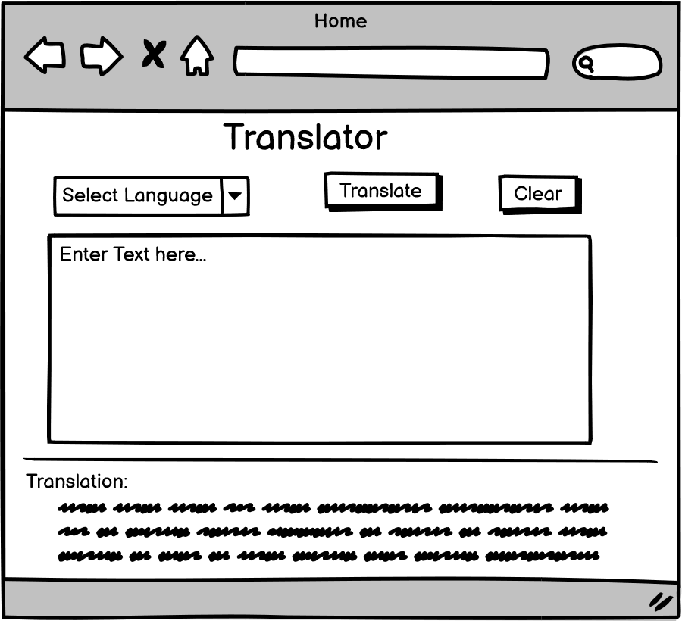
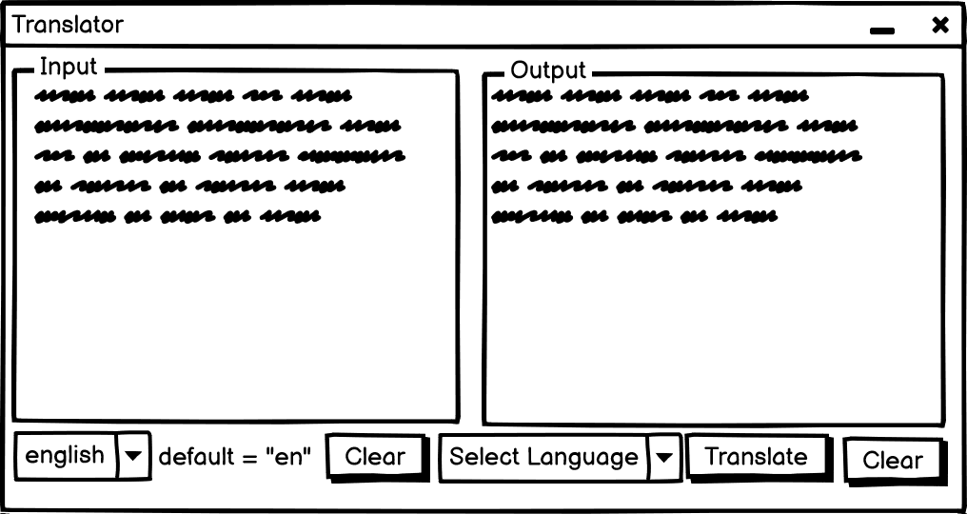
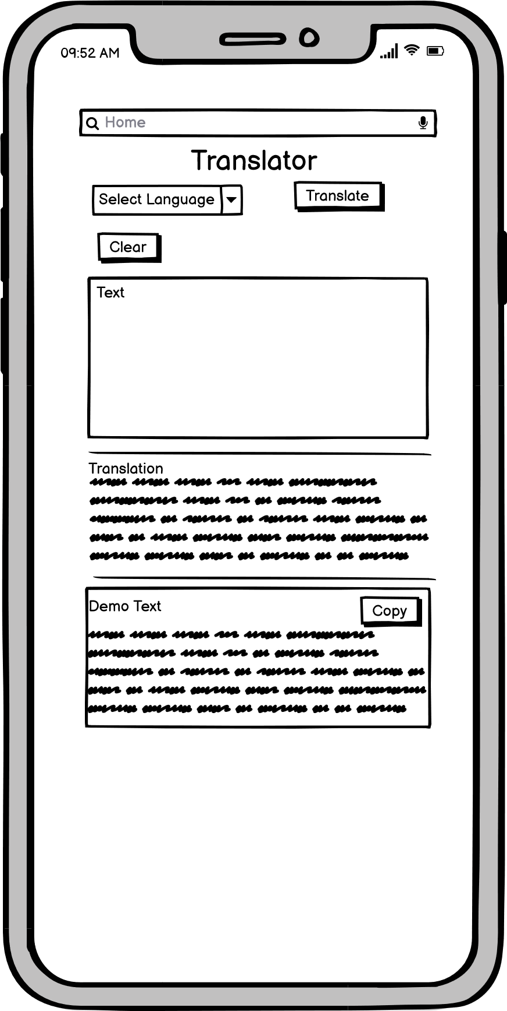
Language
Translator
Project
Standalone and web application.

Slide 2
Outline
Introduction
Existing Method
Proposed method with Artitecture
Implementation
Forms

Slide 3
Introduction
A language translator application can be an easy go-to tool to provide translations to multiple languages for a given text format.
In recent days, trending technologies such as Artificial Intelligence, ML Linguistic Models and so on are vibrant. That’s probably making the Smartphone users look for smarter apps which makes their life simple. A Translator supports text translation in many, up to 108 language variations. We can use it every day for business, travel, and education.

Slide 4
What customers do today
Many of such professional Interpreters are hired to translate oral/text based, manually with their expertise of being multilinguistic.
Online consultancy and guidance can achieve thorough Forum and personal web sites to answer grievances but they fail to be as fast as the current options.
Other DIY solutions would suggest a published copy of notes that help with interpretation tasks that users may have to pursue on their own, risking the spurious equivalents between the source and target language texts

Slide 5
Solution Proposal

Slide 6
System
Architecture
01
For standalone application

Slide 7
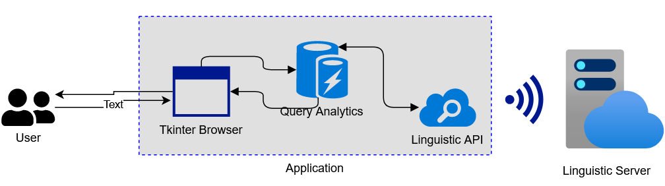
01

Slide 8
Web
Application
02
For web application

Slide 9
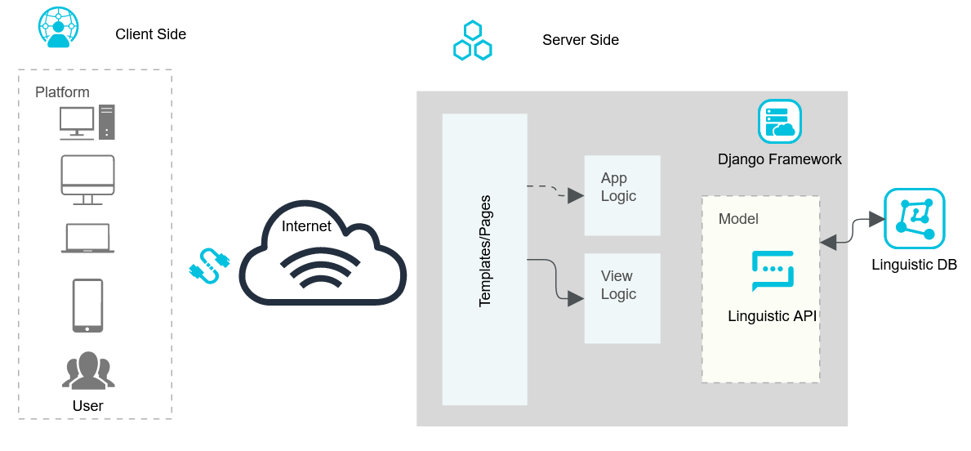
02

Slide 10
Implementation
Django framework provides all the server side handling resources and database connectivity.
External linguistic API is used to send requests to google translator linguistic servers to process the request.
Bootstrap 4 CDN used to develop front-end Templates to get user queries. Jinja used to insert content dynamically.
Request is handled by Views, forwarded the data schema from Models, to provide integrity.
For desktop application, a similar translator API is utilized to process the queries and provide results.

Slide 11
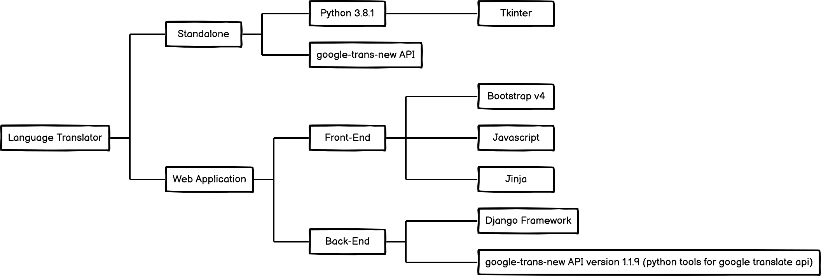
TECHNOLOGIES

Slide 12
Solution description
User connects with the system via the internet and submits a query.
Proposed system can automate the interpretation process of text-based translation.
System would keep track of all the present variantes of required languages for future queries and instant translation requirements.
Aims to process queries faster and quicker response.
Reliability, as the system refers to an ever expanding linguistic database via API.

Slide 13
Why it’s better than existing solutions
Correctness⇒Aim to provide an expert translation system, to text-based input, into required language translated text.
Accessible⇒Available on request. Mobility and Responsiveness
Reliability⇒Support as many languages as possible to provide translations.
Usability⇒User-friendly and summarized.
Flexibility⇒Replacing human interaction with one-to-many service agent, ondemand.
Portability⇒System is ported to a desktop application.
Efficiency⇒Uses framework for consistency and integrity.

Slide 14
Django Framework

Slide 15
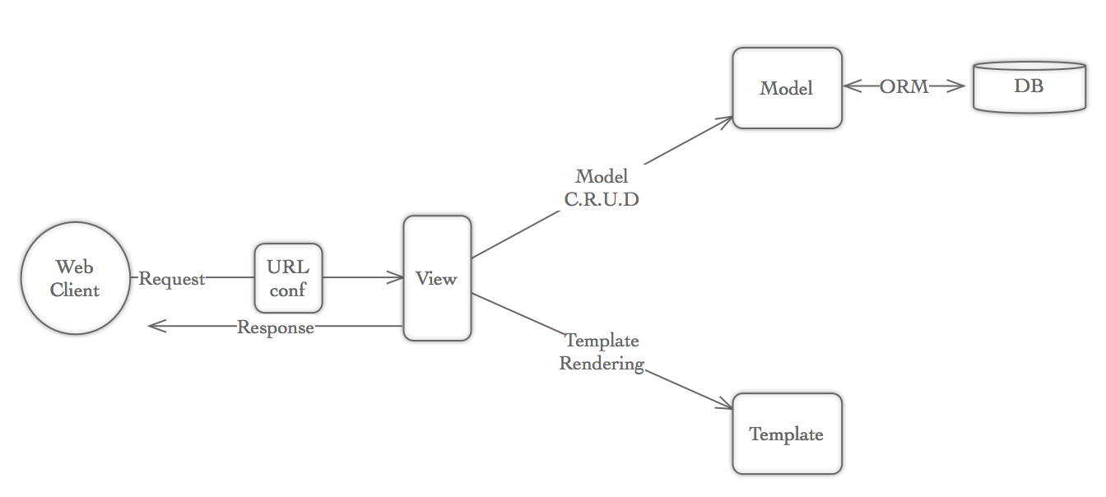

Information architecture
Tip | Just like MVC, Django uses MODEL-VIEW-TEMPLATE

Slide 16
Forms

Slide 17
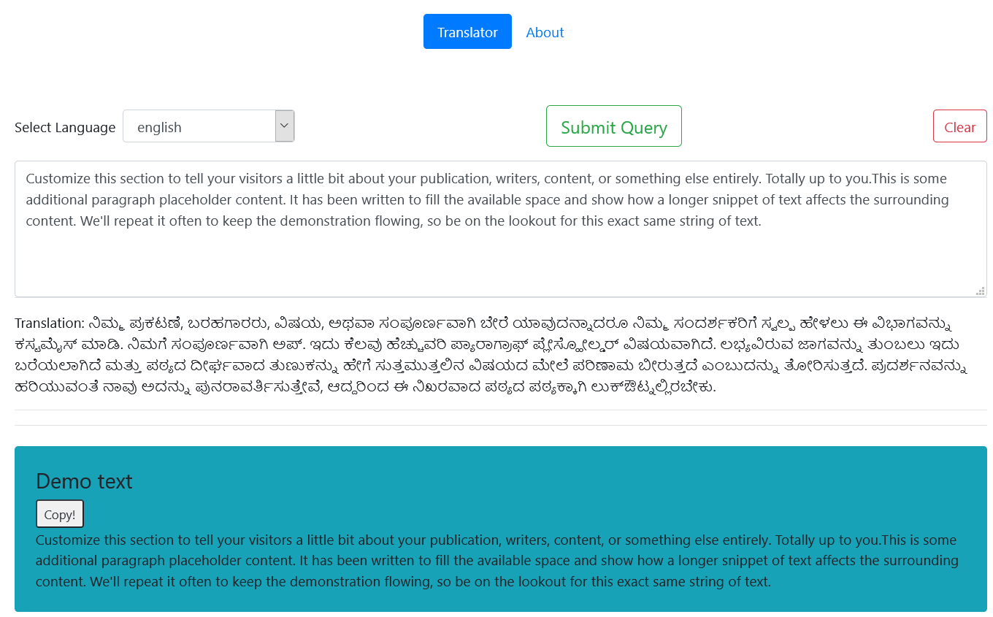
Translator web application
Text to be translated
Tip | User can copy paste upto 5000 char at a time.

Slide 18
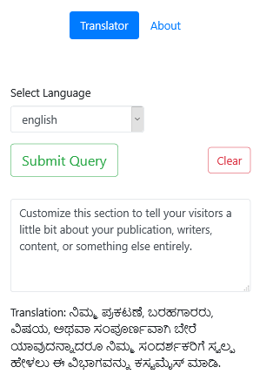
Component Detail (Mobile)
Responsive Support for the web page, due to Bootstrap 4

Slide 19
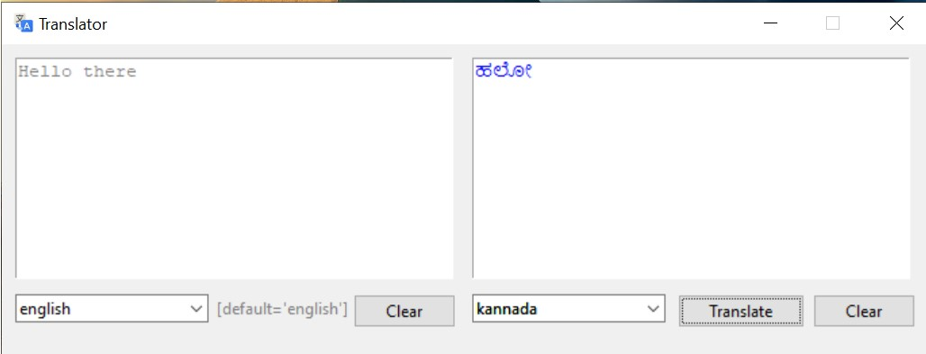
Standalone Application
Mini application built using Tkinter

Slide 20
THANK YOU
Presentation by Devanshu Rakesh Soni
End of Slide

